Slide 1
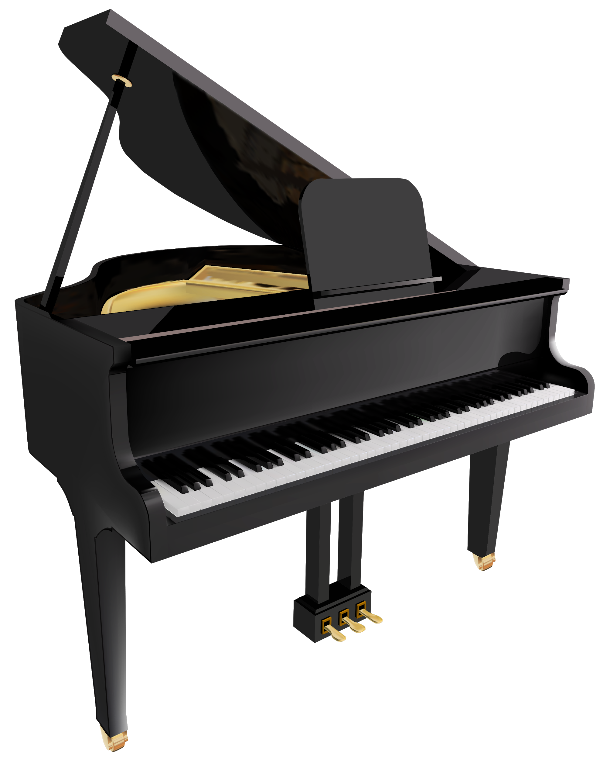
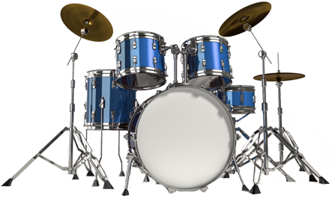
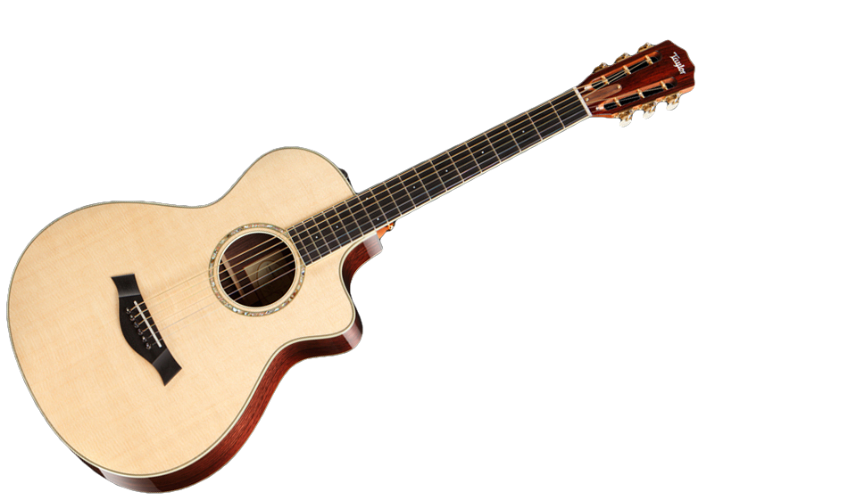
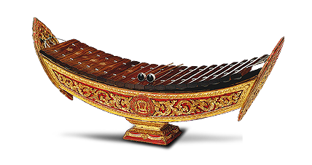
JJMM VIRTUAL
MUSIC BAND
MINE Lab
Group member
(Joe)...Rachanon Chomphoo (Guitar)
2. (Jeep)...Smart Lilitkulpanich (Ranat-Ek)
3. (May)...Pattaravadee Kantabusabong (Piano)
4. (May)...Chanunya Hongsavinitkul (Drum)
Supervised by Prof. Timothy K. Shih

Slide 2
Outline
Motivation
Hardwares and Softwares required
Methodology
Demo
Conclusion and problem

Slide 3
Motivation
“Music can change lives. Whether you are having a good or bad day, the power of music can change one’s mood” – Jess Bowen
In the future, people do not need to buy the instrument any more and they can play by using virtual instrument.
With virtual music instruments, people can enjoy the melody at anytime and anywhere.

Slide 4
Hardwares & Softwares
Required

Slide 5
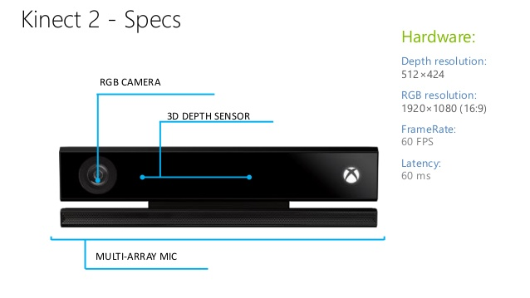
Hardware - Kinect V2 (for Xbox One)
Kinect enable users to control games, movies, music through physical motion or voice recognition. Kinect identifies each players through face recognition and voice recognition without any intermediary device such as a input controller like keyboard or joystick.

Slide 6
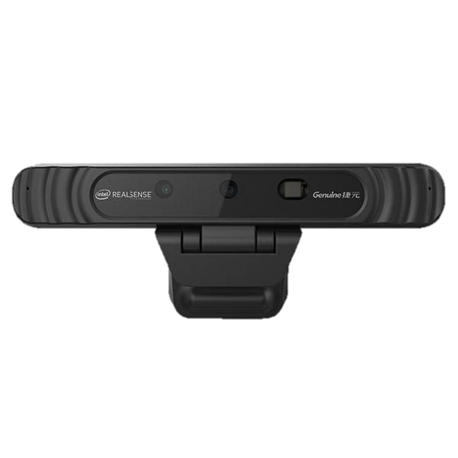
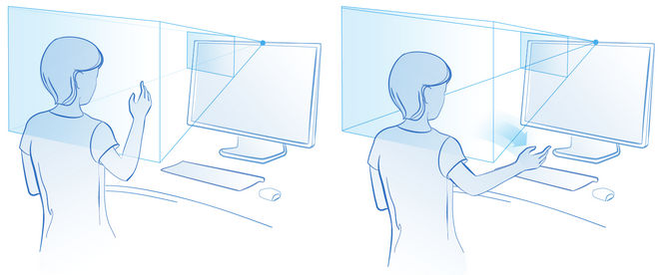
Hardware - Intel Realsense 3D
Intel Realsense 3D Camera is a stand-alone camera that can be attached to a desktop or laptop computer. It is intended to be used for natural gesture-based interaction, face recognition, immersive, gaming and learning and 3D scanning.
IR depth camera
Color camera
IR Laser
Projector

Slide 7




Softwares - Microsoft Visual Studio 2013, 2015 and 2017
Processing 3

Slide 8
Processing 3
2. Processing
Processing is an open-source graphical library and integrated development environment (IDE) built for the electronic arts, new media art, and visual design communities
Processing uses the Java language, with additional simplifications such as additional classes and aliased mathematical functions and operations.

Slide 9
Processing 3
with Processing Libraries
Kinect V2 for Processing
  Use to connect with kinect to tracking the body, joint, or hand.
Minim
  Use to import the audio file to play the sound.

Slide 10

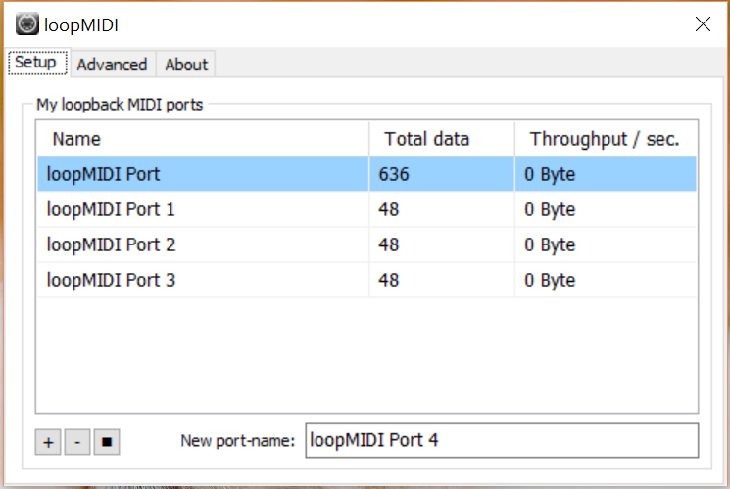
Softwares - LoopMIDI
5. LoopMIDI
loopMIDI is a tiny app that can create and use virtual loopback MIDI ports.
It makes use of the virtual MIDI driver to create the virtual ports.

Slide 11
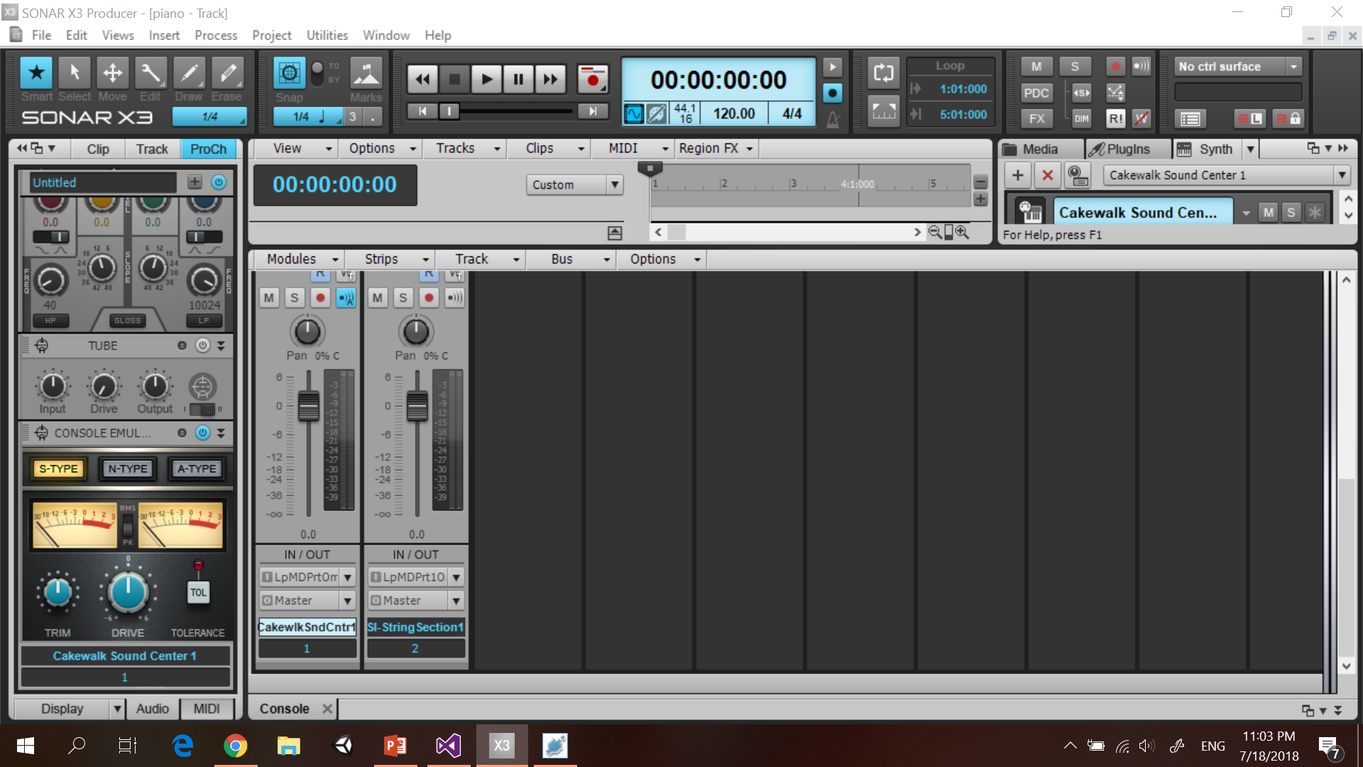
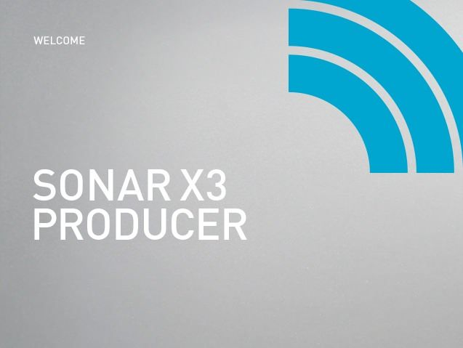
Softwares - SONAR X3 Producer
6. SONAR X3 Producer
SONAR X3 Producer is Cakewalk’s flagship DAW (digital audio workstation).
This program used to create and record with unlimited audio and MIDI tracks (Piano keys)
Notes:
jhhhhhhhhh

Slide 12
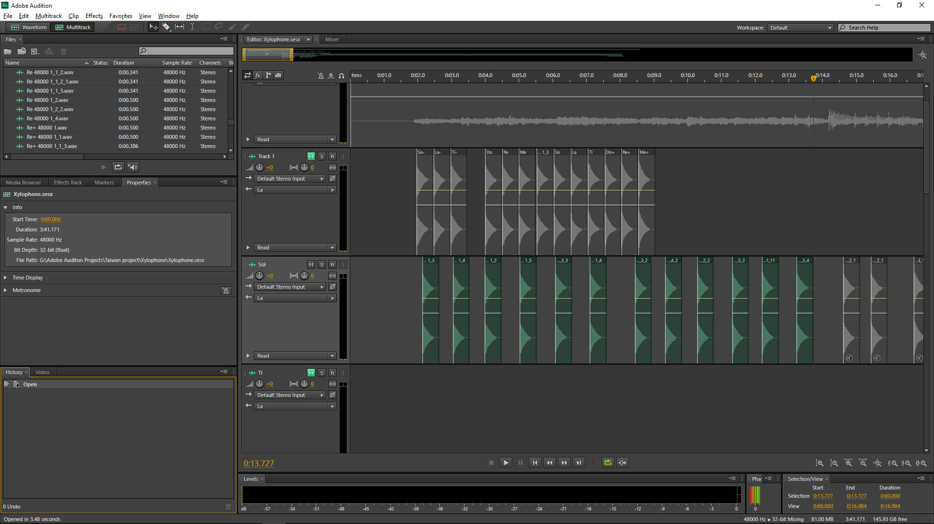

Softwares - Adobe Audition CS6
To Adjust some pitch of Thai Xylophone sounds.

Slide 13


Softwares - OBS & oCam
8. OBS and oCam are free and open source software for captures and records onscreen images, video and audio.

Slide 14
Methodology

Slide 15
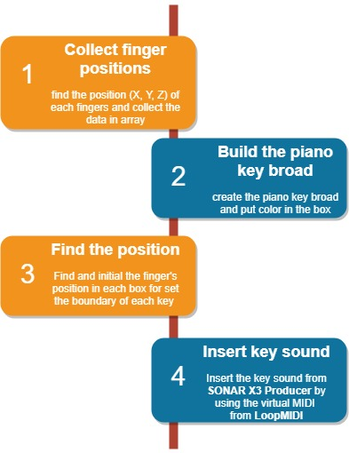
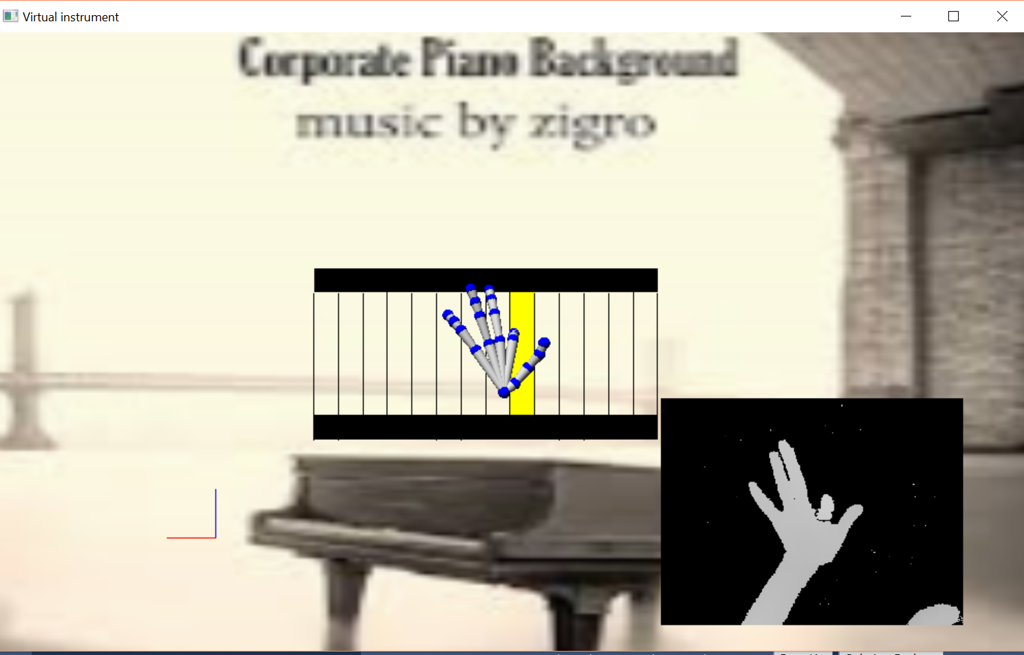
Methodology of Virtual Piano

Slide 16
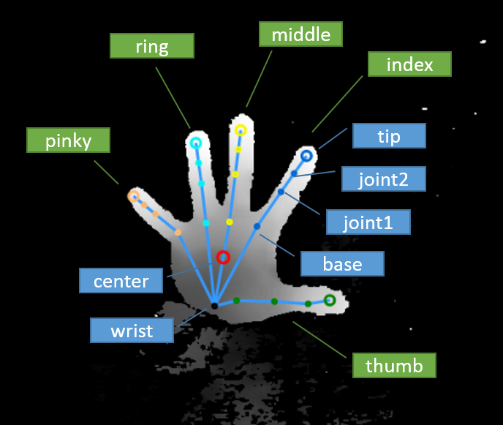
Piano Hand Skeleton Tracking
Since inertial sensors are tracking only rotations, the rotations have to be applied to some hand skeleton in order to get proper output. To get precise output (for example to be able to touch the fingertips), the hand skeleton has to be properly scaled to match the real hand. For this purpose manual measurement of the hand or automatic measurement extraction can be used.

Slide 17
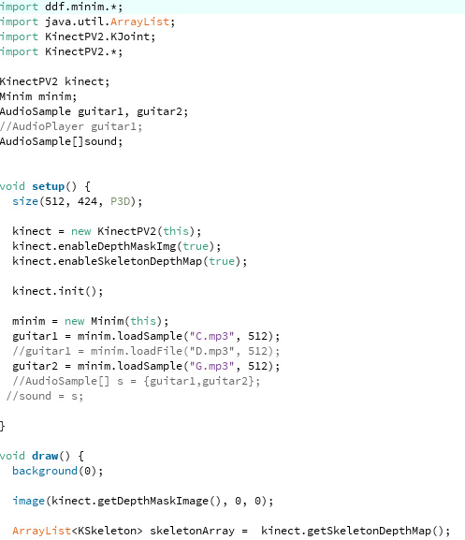
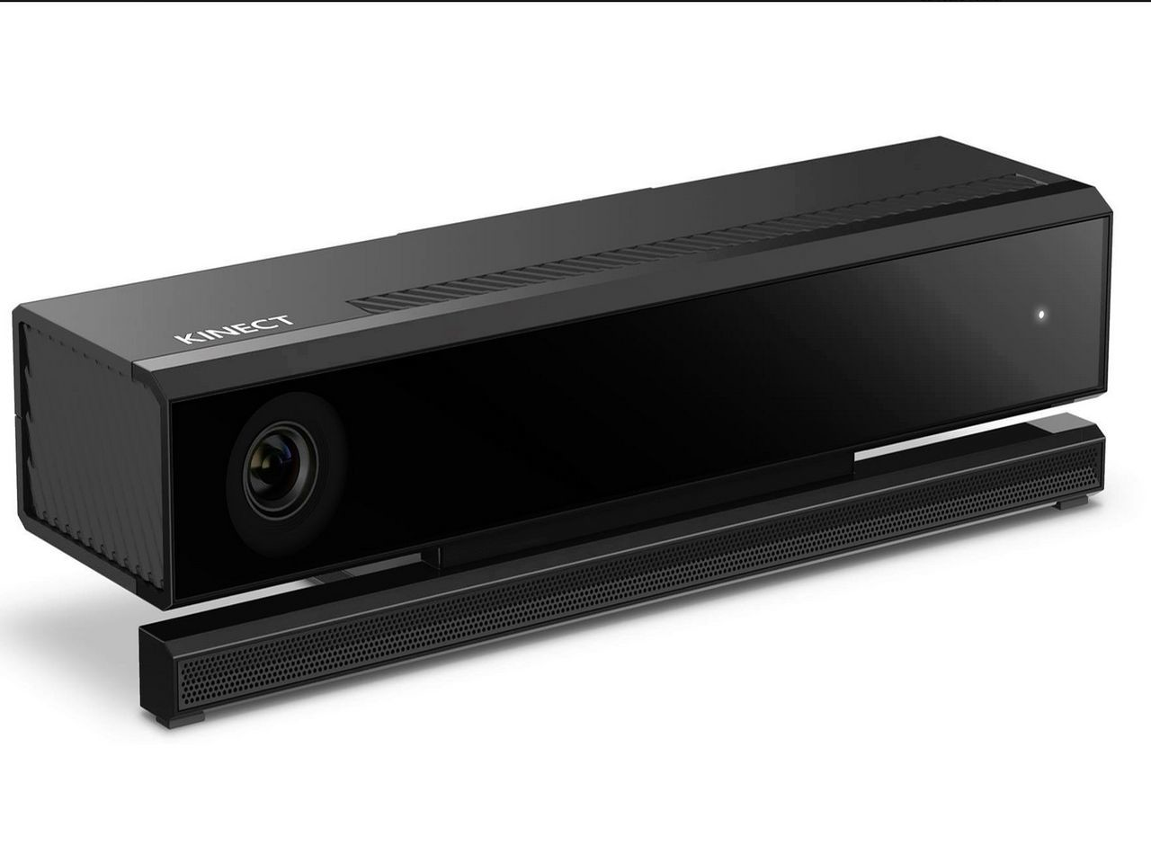
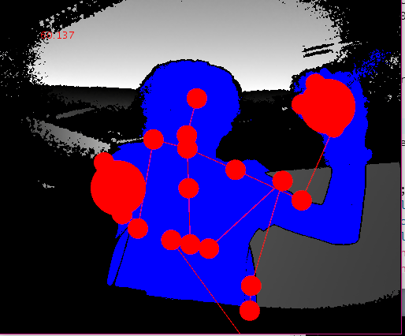
Guitar Hand Tracking
For the virtual guitar. we implement the program to track joint of the body by processing 3 software. Our program provides many actions which we can control the sound. For example, when a user hold all fingers down, the program will generate the sound according to specific chords.

Slide 18
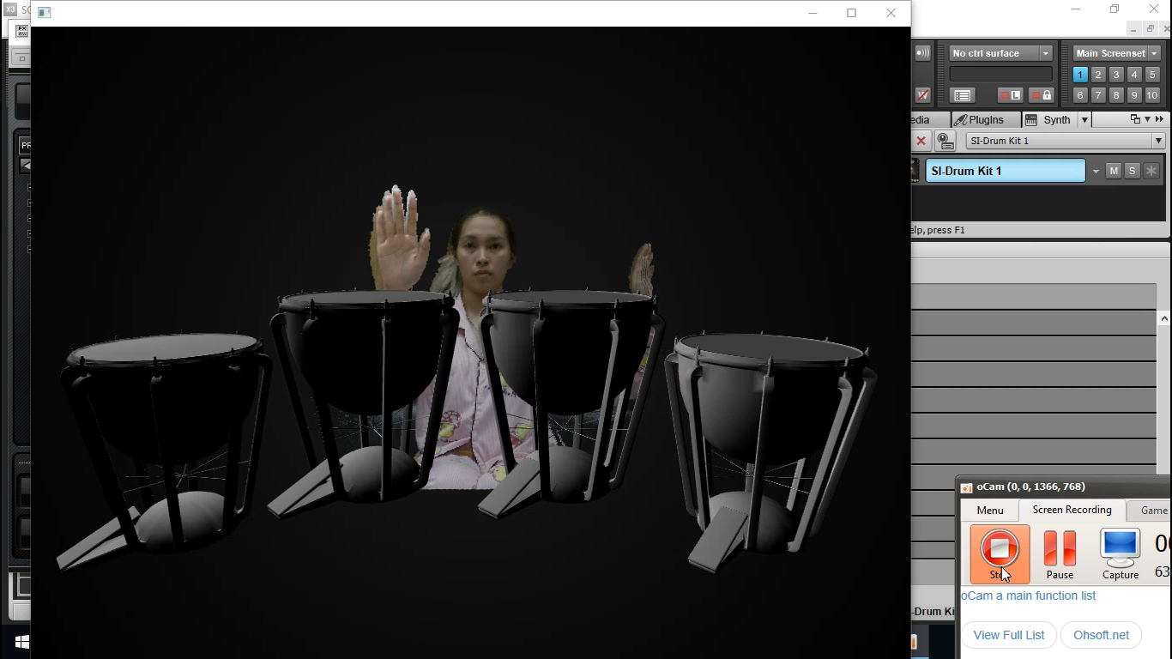
Drum Hand Tracking
We use Virtual Studio2015 for implement program and Kinect V.2 . For the drum, there are 4 sounds according to the position of user’s hand.

Slide 19
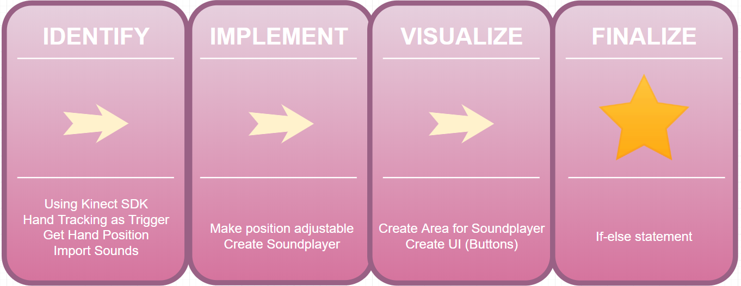
Ranat ek - Methodology

Slide 20
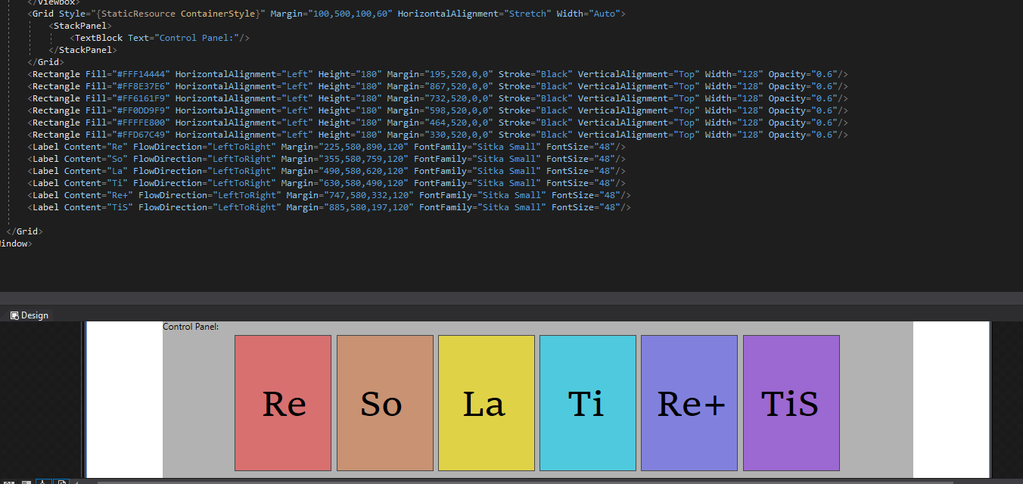
Ranat ek - Example of Coding

Slide 21
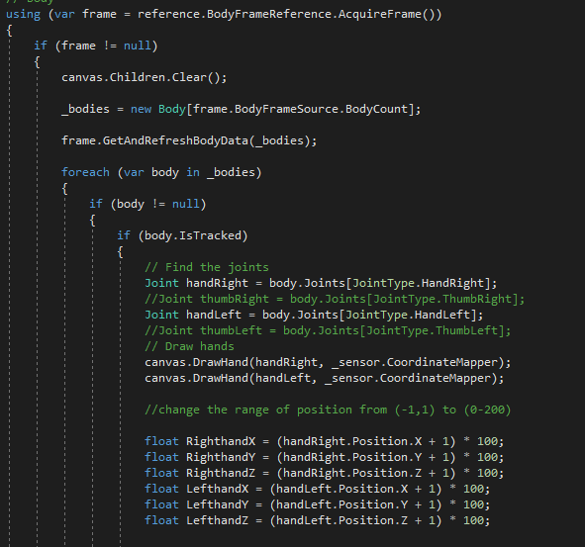
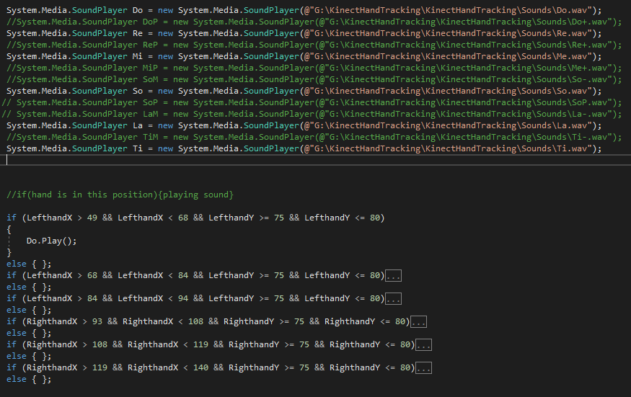
Ranat ek - Example of Coding

Slide 22
DEMO
Experimental Result

Slide 23
Jingle bell (Piano)

Slide 24
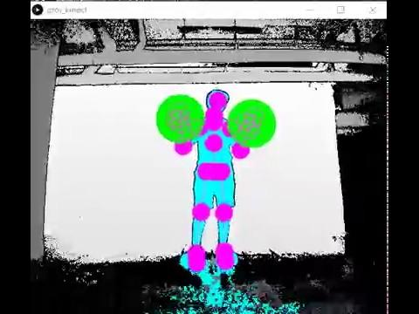
Happy Birthday (Guitar)

Slide 25
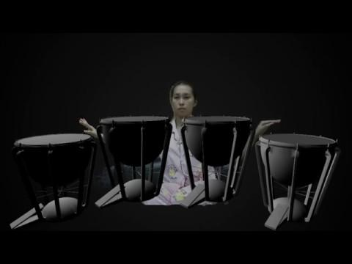
Perfect (Drum)

Slide 26
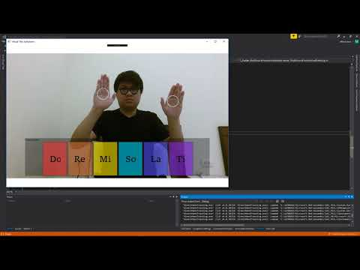
ranat ek วิดีโอแปะทับหน้านี้เลย
Jingle Bell (Thai Ra-Nat Ek)
Notes:
https://youtu.be/heJ6LRKyYbY

Slide 27
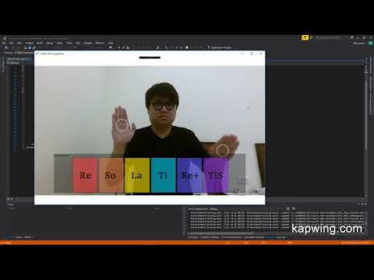
First part of Tua-Rai-Tee-Luk-Ter
Notes:
https://youtu.be/5yAS8VPERB8

Slide 28
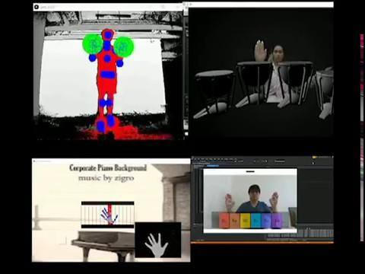
All instruments demo….
to be cont…...

Slide 29
Conclusion and Problems
We can implement 4 virtual music instruments (Piano, Guitar, Drum and Ranat-Ek) and successfully give some demonstrations.
The device has some issues when it tracks the hand or finger position.
Use MIDI instead of soundplayer (Only Thai Xylophone).
Working on 3D Models and be able to play it like a real Ranat-Ek
We will improve visuals & UI.

Slide 30
References
Nicen Sensteen, “Thai Ra-nat Ek Sounds”,
online: https://www.youtube.com/watch?v=Y7XB94sFeuU, Jul 5, 2017
Vangos Pternas, “Hand tracking Guideline (Visual Studio 2017)”,
online: https://pterneas.com/2014/03/21/kinect-for-windows-version-2-hand-tracking/, March 21, 2014

Slide 31
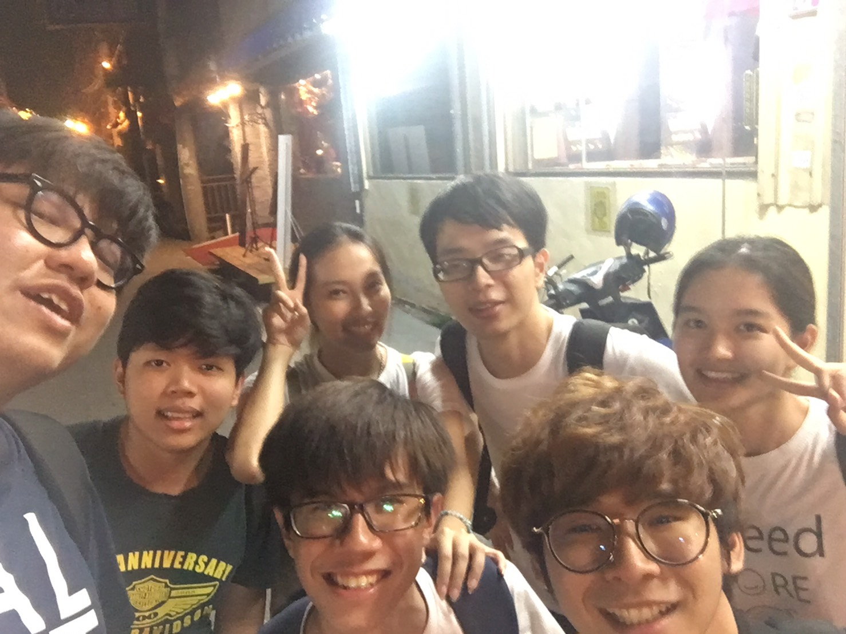
Thank you for your advice
Professor Timothy K. Shih
Cheng-Ting Wang (Senior Advisor)
A Liang (Senior Advisor)
Shi Yen (Senior Advisor)
P’Por
P’Tip
P’Tle

Slide 32

Thank you for your attention
Notes:
:)

